Slide 1
CFG = PDA

Slide 2
CFG = PDA
We are now able to prove that the set of all languages accepted by PDAs is the same as the set of all languages generated by CFGs.
We can prove this in two steps.

Slide 3
Theorem 30 and 31
Theorem 30:
Given a CFG that generates the language L, there
is a PDA that accepts exactly L.
Theorem 31:
Given a PDA that accepts the language L, there
exists a CFG that generates exactly L.

Slide 4
Proof of Theorem 30
The proof will be by constructive algorithm.
From Theorem 26 in Chapter 13 (page 278), we can assume that the CFG is in CNF. (We shall handle the problem of λ later.)

Slide 5
Algorithm
Given a CFG in CNF as follows:
X₁ → X₂X₃
X₁ → X₃X₄
X₂ → X₂X₂
…
X₃ → a
X₄ → a
X₅ → b
…
where the start symbol S = X₁ and the other non-terminals are X₂, X₃, ...

Slide 6
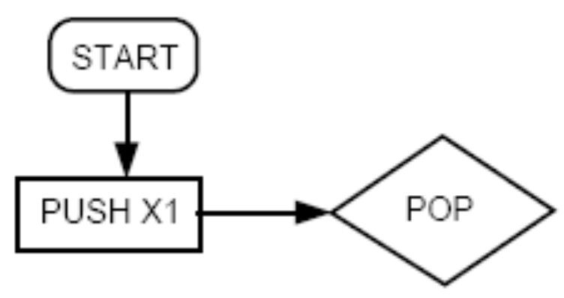
Algorithm (contd.)
We build the corresponding PDA as follows:
We begin with

Slide 7
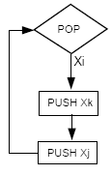
Algorithm (contd.)
For each production of the form
X_{i} → X_{j}X_{k}
We include this circuit from the POP state back to itself:

Slide 8
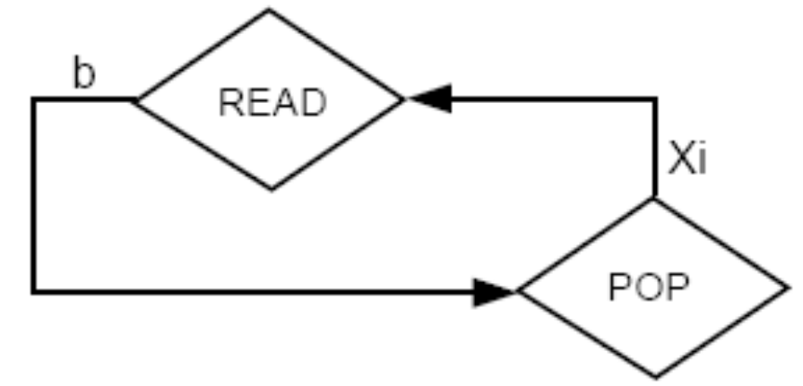
Algorithm (contd.)
For each production of the form
X_{i} → b
We include this circuit:

Slide 9
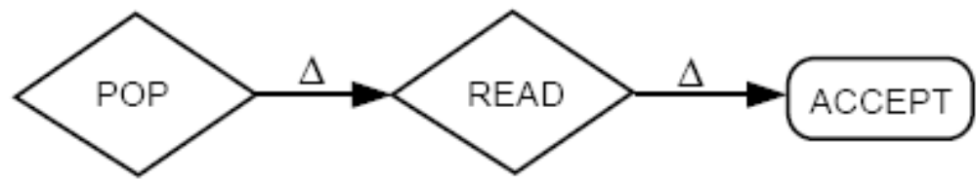
Algorithm (contd.)
When the STACK is empty, which means that we have converted our last non-terminal to a terminal and the terminals have matched the INPUT TAPE, we add this path:

Slide 10
Algorithm contd.
From the reasons and example above, we know that all words generated by the given CFG will be accepted by the PDA, and all words accepted by this PDA will have leftmost derivations in the given CFG.
At the beginning we assumed that the CFG was in CNF. But there are some CFLs that cannot be put into CNF. These are the languages that include the word λ.

Slide 11
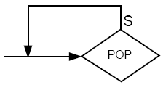
Algorithm contd.
In this case, we can convert all productions into CNF and construct the PDA as described above. In addition, we must also include λ. This can be done by adding a simple circuit at the POP:
This kills the non-terminal S without replacing it with anything. So, the next time we enter the POP, we get a blank and can proceed to accept the word.

Slide 12
Example
Consider the following CFG in CNF:
S → SB | AB
A → CC
B → b
C → a
We now propose the following nondeterministic PDA where the STACK alphabet is
Γ = {S, A, B, C}
and the TAPE alphabet is only
∑ = {a, b}

Slide 13
We begin by pushing S onto the top of the STACK.
We then enter the central POP state. Two things are possible when we pop the top of the STACK:
  We either replace the removed non-terminal with two other non-terminals, thereby simulating a production,
  Or we go to a READ state, which insists that we must read a specific terminal from the TAPE, or else it crashes.
To get to ACCEPT, we must have encountered the READ states that wanted to read exactly the letters on the INPUT TAPE.
We now show that doing this is equivalent to simulating a leftmost derivation of the input string in the given CFG.

Slide 14
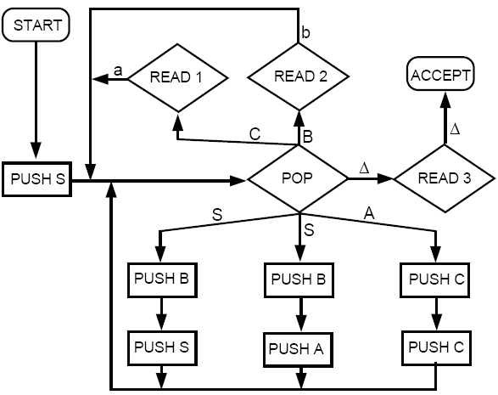

Slide 15
Example
Let’s consider a specific example. Let’s generate the word aab using leftmost derivation in the given CFG:
Working string Production used
S ➔ AB S → AB
➔ CCB A → CC
➔ aCB C → a
➔ aaB C → a
➔aab B → b

Slide 16
Let us run this word (aab) on the proposed PDA, following the same sequence of productions in the leftmost derivation above.

Slide 17



We begin at START
We push the symbol S on the STACK
We then go to POP state. The first production we must simulate is
S → AB. So, we POP S and then PUSH B and PUSH A:

Slide 18



We go back to POP. We now simulate A → CC by popping A and do PUSH C and PUSH C:
Again, we go back to POP. This time, we must simulate C → a by poping C and reading a from the TAPE:
We simulate another C → a:

Slide 19

We now re-enter the POP state and simulate the last production, B → b. We POP B and READ b from the TAPE
At this point the STACK is empty, and the blank ∆ is the only thing we can read next from the TAPE.
Hence, we follow the path
POP ∆➔ READ3 ∆➔ ACCEPT
So, the word aab is accepted by the PDA.

Slide 20
It should also be clear that if any input string reaches the ACCEPT state in the PDA, that string must have got there by having each of its letters read via simulating the Chomsky production of the form
Nonterminal → terminal
This means that we have necessarily formed a complete leftmost derivation of this word through CFG productions with no nonterminals left over in the STACK. Therefore, every word accepted by this PDA is in the language generated by the CFG.

Slide 21
Example
The language PALINDROME (including λ) can be generated by the following CFG in CNF (plus one λ-production):
S → AR₁ | BR₂ | AA | BB | a | b| λ
R₁ → SA
R₂ → SB
A → a
B → b
Using the algorithm above, we build the following PDA that accepts exactly the same language:

Slide 22
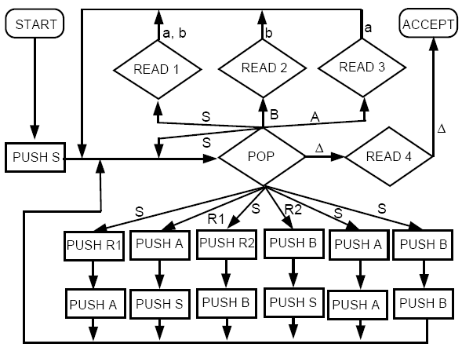

Slide 23
The proof of Theorem 31 is not included in the syllabus; however, you are encouraged to read it from the text.
Theorems 30 and 31 together prove that the set of all languages accepted by PDAs is the same as the set of all languages generated by CFGs.

